Slide 1

Software Requirement Engineering
Fast-National University of computer & Emerging Sciences

Slide 2
Agenda
Instructor’s Introduction
Course Introduction
Difference between want/need and Requirement
What is Requirement? Software Requirements , Sources of Requirements
The Goal of Software Development
Root Causes of Project Success and Failures

Slide 3
About the Instructor
Lecturer
MS(SE) –FAST NUCES(2017-2019)
Medalist
BS(SE)-FOUNDATION UNIVERSITY
Distinction
Over 3 years of industry and academia experience
Expertise: Game Developer, 3d modeling, Designing , Software Testing, UML, Software Engineering,

Slide 4
Contact Information
Room C503 F,5th floor, FAST NU Islamabad Campus.
Tel: 111 128 128 (Ext.504)
Email: shafaq.riaz@nu.edu.pk
Google Chat
Preferred mode of communication
Visiting hours
By appointment

Slide 5
Google Class Room Code
Google Classroom code.
svk5dmc

Slide 6
Submission rules
Submission of late assignment will reward “0”.
Late includes
1 min
2 min
5 min
50 min
No submission accepted on gmail.
No submission accepted without turn in on google classroom

Slide 7
Class Room Conduct & Ethics
Students are required to ensure 100% attendance in the course.
Students are not allowed to use their mobile phones or laptops during class
Students must come within 5 minutes of the start of the class
Students arriving after 10 minutes of the start of the class will be marked as ‘Absent’.
I will not entertain any request of changing attendance or the so called “un-debar request’,rather strict action will be taken against such students.

Slide 8
Queries rules
Your queries will entertain within a day after the marks are uploaded on the flex
No query will be entertained at the end of the semester

Slide 9
Rules
No “average marks” possible for missing sessional and final exams.
Retake of missed assessment items (other than midterm/ final exam) will not beheld.
For a missed midterm/ final exam, an exam retake/ pretake application along
with necessary evidence are required to be submitted to the department
secretary. The examination assessment and retake committee decides the exam
retake/ pretake cases.

Slide 10
Course Plagiarism Policy
Plagiarism in project or midterm/ final exam may result in F grade in the course.
Plagiarism in an assignment will result in zero marks in the whole assignments category.

Slide 11
About the Course
Requirement Engineering – SE2001
Course Category :- Software Engineering
Course level :- Undergraduate
Credit Hours :- 3
Pre- requisite :- Intro to SE
Your Expectation?
Theoretical?

Slide 12
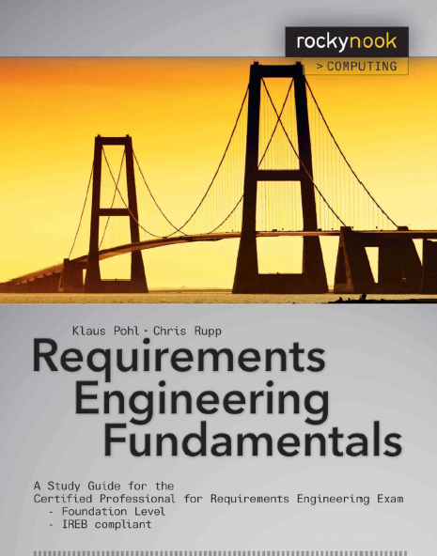
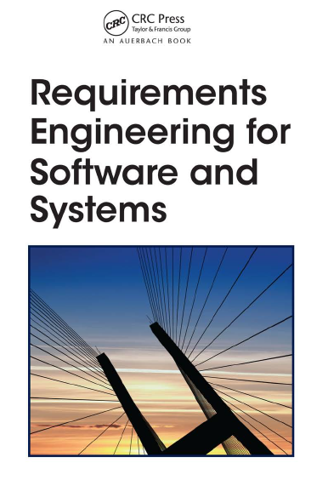
Reference Books
Requirements Engineering Fundamentals A Study Guide for the Certified Professional for Requirements Engineering Exam: Foundation Level – IREB compliant by Klaus Pohl · Chris Rupp
Requirements Engineering for Software and Systems Phillip A. Laplante 1-4200-6467-

Slide 13
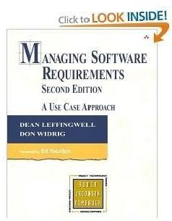
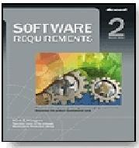
Reference Books
4
Managing Software Requirements: A
By
Use Case Approach,
Second Edition
Dean Leffingwell, Don Widrig,
Addison-
Wesley
Software Engineering 7th Pressman
Edition By Roger
Software Edition
E. Wiegers Press
Requirements,
by
Second
Karl
ISBN:0735618798, Microsoft

Slide 14
Why SRE?
According to past studies, approximately 60 percent of all errors in system development projects originate during the phase of requirements engineering
These errors, however, are often discovered only in later project phases or once the system has been deployed because incorrect or incomplete requirements can be interpreted by developers in such a fashion that they are subjectively sound or (subconsciously) complete.

Slide 15
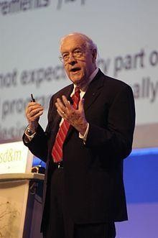

Importance of Software Requirements
15
The hardest single part of building a software system is deciding what to build….. No other part of the work so cripples the resulting system if done wrong. No other part is difficult to rectify later. (Fred Brooks)

Slide 16
Issues in requirements engineering?
Missing Requirements
Implementation of Developers
Unclear , Incomplete ,Wrong Requirements
Notes:
Missing requirements often remain undetected during design and realization because developers trust the requirements engineers to deliver high-quality work.
Developers implement whatever the requirements document says or what they believe it to be saying. Unclear, incomplete,
or wrong requirements inevitably lead to the development of a system that does not possess critical properties or possesses properties that were
not requested.

Slide 17
Costs of errors during requirements engineering
The later in the development project a defect in the requirements is corrected, the higher are the costs associated with fixing it.
The National Institute of Standards and Technology concluded in a 2003 study that software defects cost the US economy about $60 billion annually. Hooks & Farry (2001) found that re-work of errant requirements consumes 28 percent to 42 percent of a project’s development costs. Boehm & Pappacio (1988) found that fixing requirements errors consumes 30 percent to 50 percent of a project’s budget.
In 2002 the Standish Group reported that the average size of a project ranged from $434,000 (small company) to $1.33 million (medium-sized company) to $2.3 million (large company). Extrapolations of these data for the average project yield expenditures on requirements errors ranging from $108,000 to $920,000.

Slide 18
Symptoms and causes of deficient requirements engineering
It can lead to going over the budget
It can cause the team to fall behind schedule
Or it can cause the team to abandon the project all together

Slide 19
The significance of good requirements engineering
Complete requirements free from defects are the basis for successful system development.
Potential risks have to be identified during requirements engineering and must be reduced as early as possible to allow for successful project progress.
Faults and gaps in requirement documents must be discovered early on to avoid tedious change processes.

